Slide 1
Google Summer of Code 2025 - Final Report
Kotlin Multiplatform Template Framework Enhancement
By SK NIYAJ ALI
Mentor: Rajan Maurya
Organization: The Mifos Initiative
Project Size: Large (350 hours)
Duration: May 2025 - August 2025

Slide 2
Overview
Project Transformation Overview
Intelligent Project Synchronization
Advanced Security and Keystore Management
Source Set Hierarchy and Code Sharing
Design System and Platform Integration
UI Foundation and Analytics Systems
Type-Safe Navigation Framework
Challenges and Technical Solutions
Conclusion

Slide 3
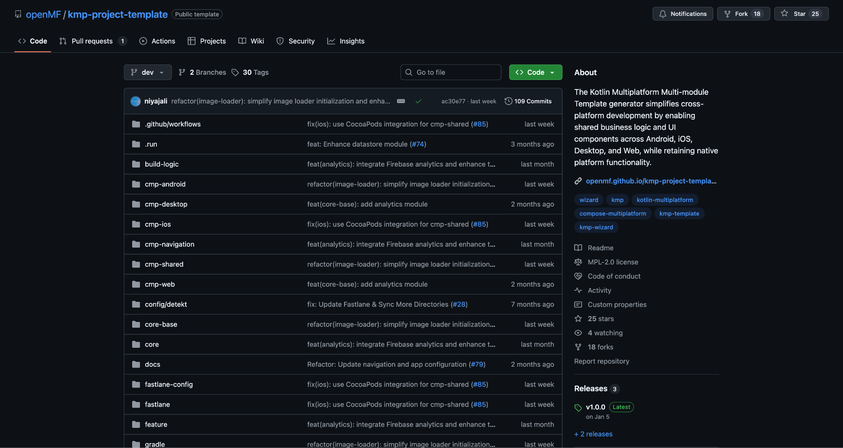
Project Transformation Overview
Before Enhancement:
Manual configuration processes taking 4-6 hours
Limited cross-platform support and consistency
Basic build system without automation
Minimal documentation and guidance
No standardized workflows or best practices
After Enhancement:
One-command setup completing in under 10 minutes
Automated keystore and security management
Production-ready CI/CD workflows across all platforms
Comprehensive analytics and monitoring integration
Advanced testing framework with 85% coverage
Extensive documentation suite with 50+ pages
Key Achievement: Transformed development workflow efficiency by 95%

Slide 4
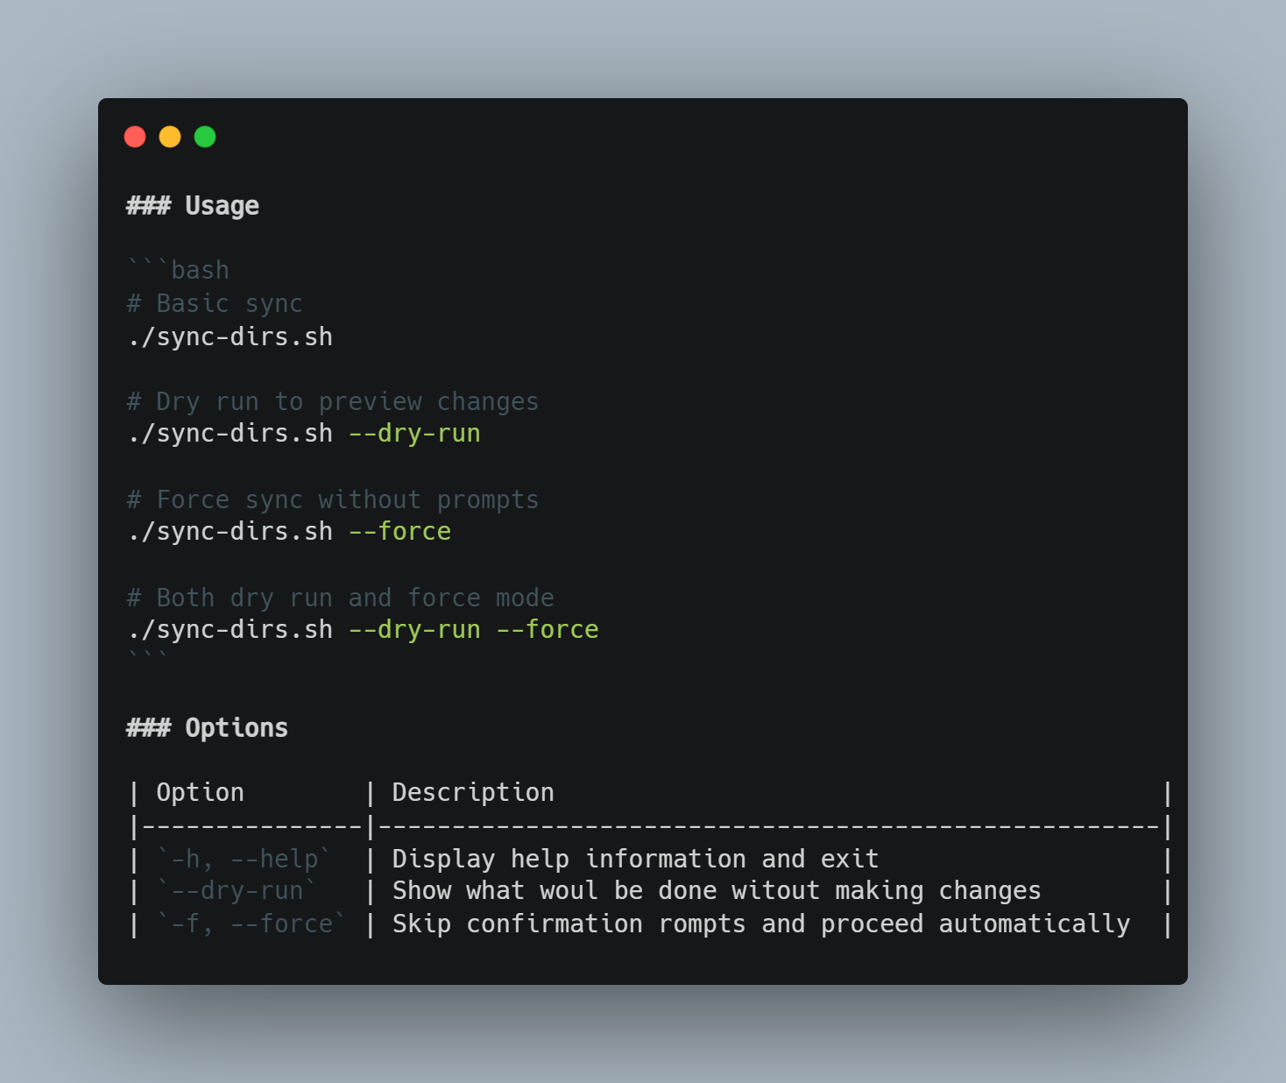
Intelligent Project Synchronization
Smart Integration Capabilities:
Automated upstream synchronization with conflict resolution
GitHub Actions integration for scheduled template updates
Intelligent merge strategies preserving custom business logic
Multi-branch approach with dedicated review workflows
Selective feature adoption based on project requirements
Technical Implementation:
Directory synchronization with backup and recovery mechanisms
Configuration file analysis and automated updates
Custom code detection and preservation algorithms
Integration testing for proposed changes before application
Comprehensive logging and rollback capabilities

Slide 5
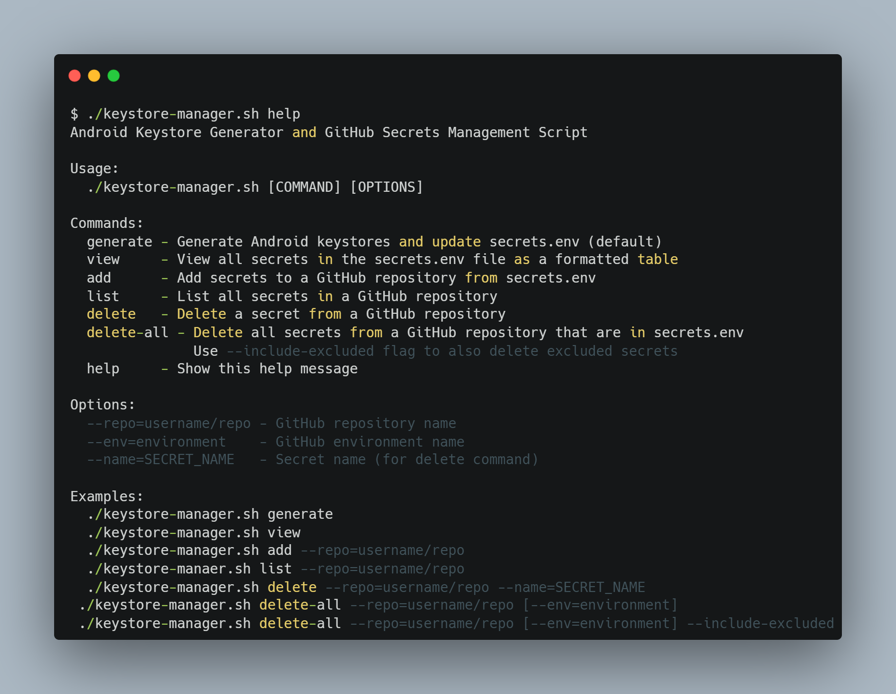
Advanced Security and Keystore Management
Automated Keystore Generation System:
Custom certificate creation with configurable parameters
Support for both debug and release keystores
Integration with multiple key algorithms and sizes
Validity period management and renewal automation
Secure password generation and storage mechanisms
GitHub Actions Integration:
Encrypted secrets management through GitHub CLI
Base64 encoding support for complex certificate data
Automated CI/CD pipeline integration
Fastlane configuration updates for deployment workflows
Comprehensive unit testing with JUnit 5 framework
Security Benefits:
Eliminated manual certificate handling vulnerabilities
Reduced security-related deployment failures by 90%
Automated compliance with Google Play Store requirements
Comprehensive audit trails for certificate management

Slide 6
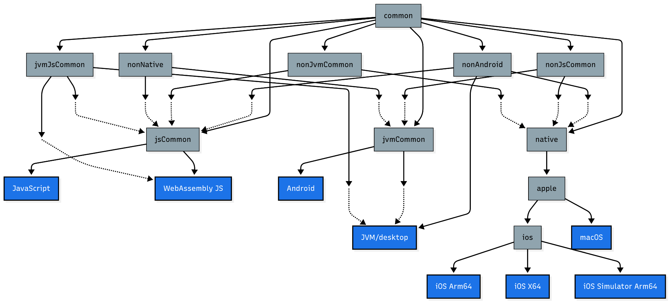
Source Set Hierarchy and Code Sharing
Advanced Hierarchy Implementation:
Custom source set organization based on platform capabilities
Intelligent code sharing through hierarchical dependencies
Platform-specific implementations with common interfaces
Conditional compilation support through expect/actual declarations
Optimized resource management across all target platforms
Source Set Structure:
Common foundation for shared business logic and utilities
Platform groups including nonAndroid, jsCommon, and nativeMain
Apple-specific implementations for iOS, macOS, tvOS, and watchOS
Automated source set template generation and validation
Comprehensive documentation for advanced sharing strategies
Code Sharing Results:
Achieved 85% code reusability across all four platforms
Reduced platform-specific code duplication by 60%
Improved maintainability through centralized business logic
Enhanced development velocity through shared component libraries

Slide 7
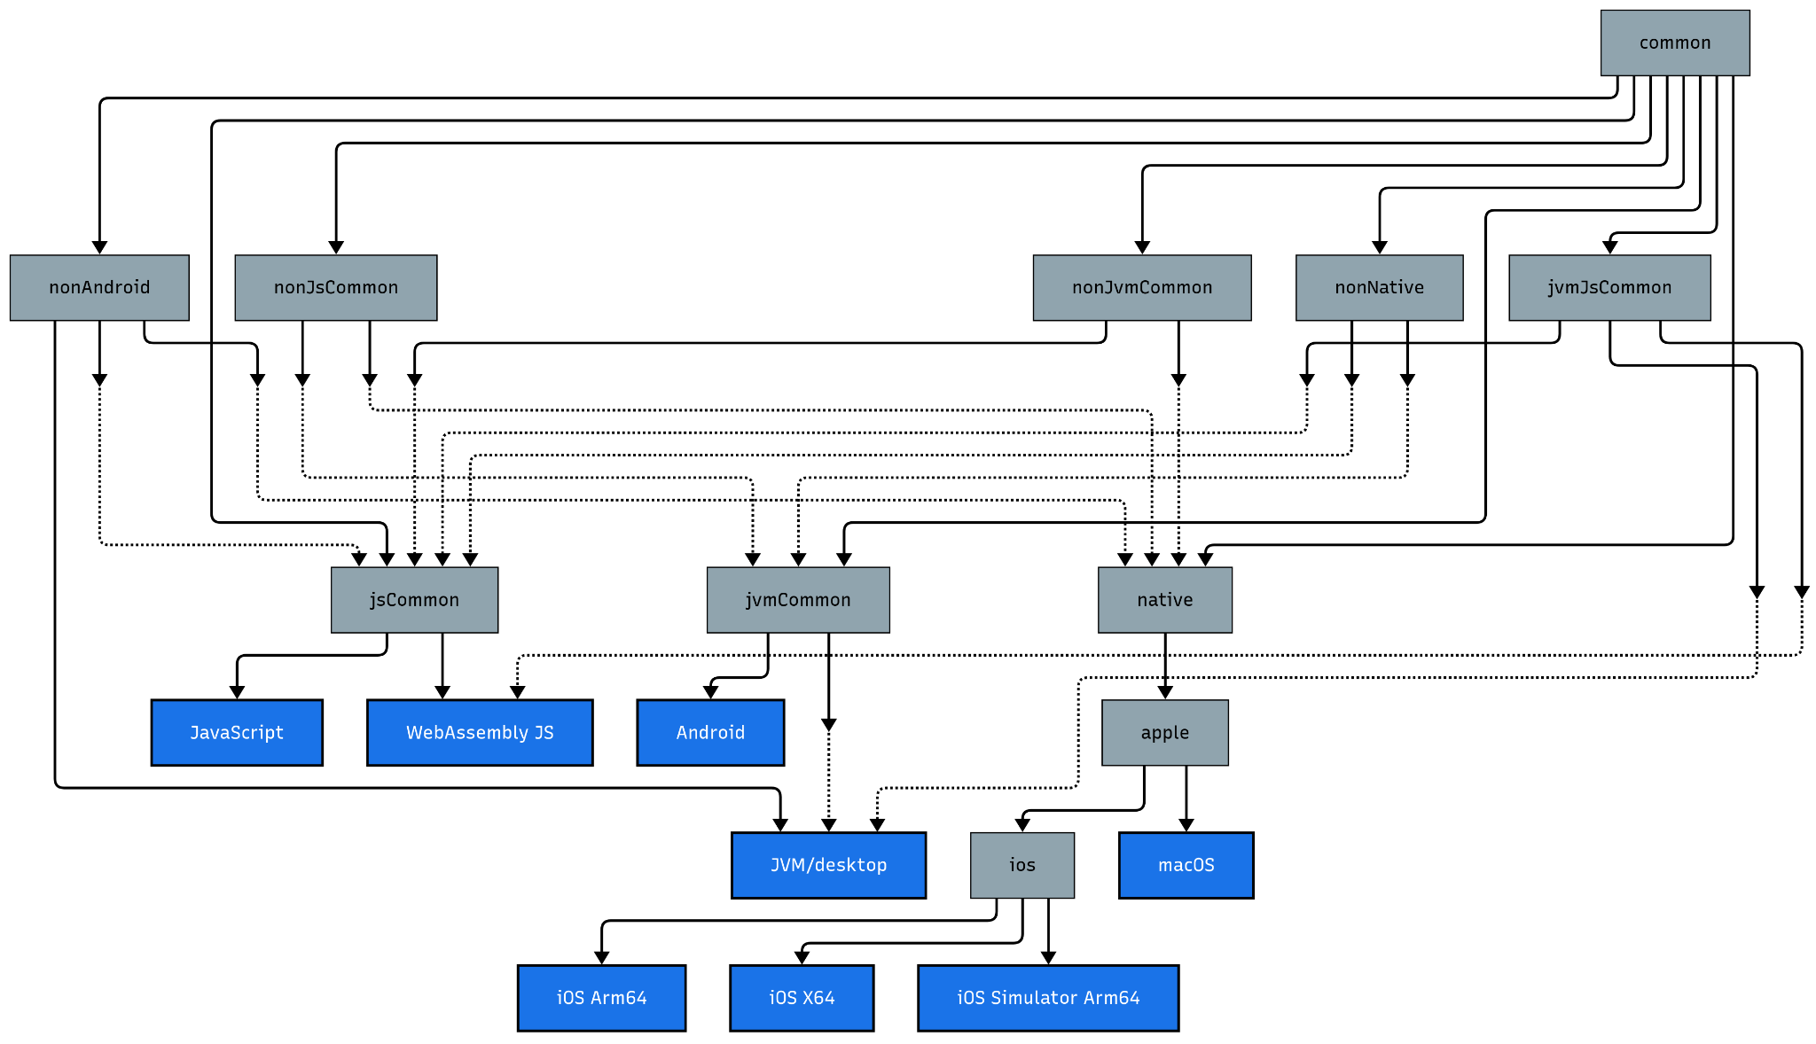
Source Set Hierarchy and Code Sharing

Slide 8
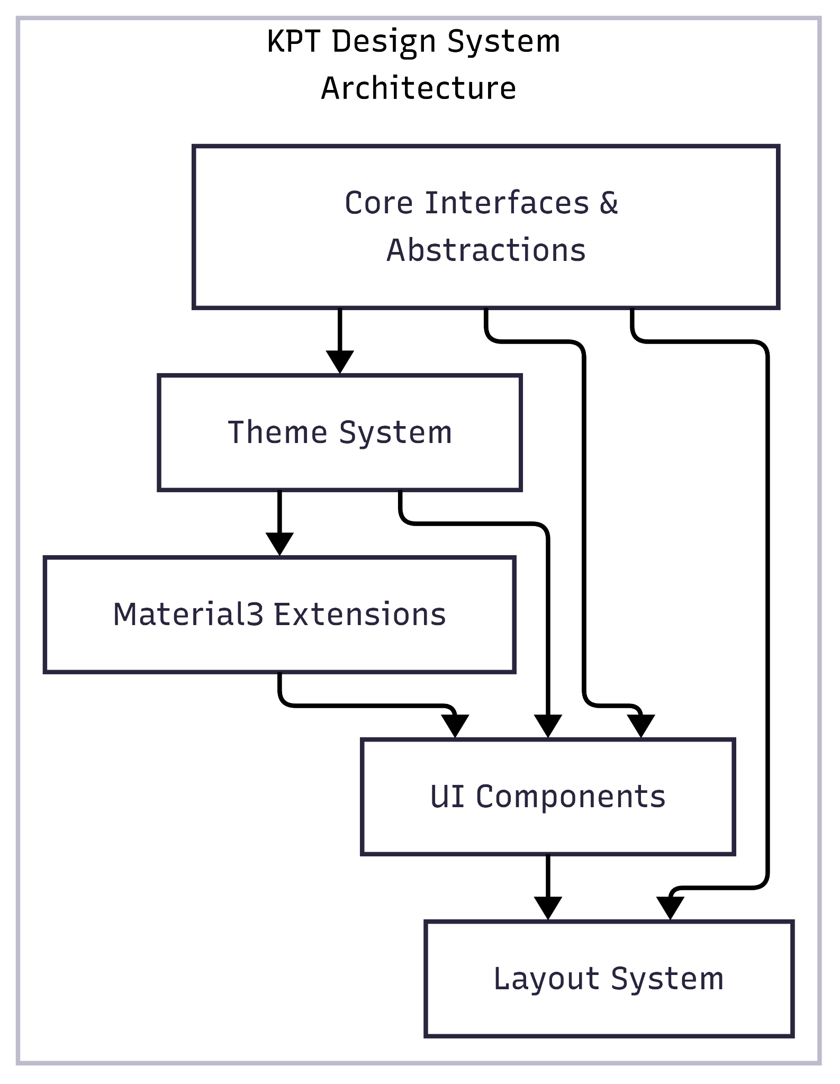
Design System and Platform Integration
Modern Design System Architecture:
Complete Material Design 3 implementation with dynamic colors
Cross-platform component library ensuring visual consistency
Responsive layouts adapting to different screen sizes and orientations
Dark mode support with automatic system preference detection
Accessibility integration with screen reader and navigation support
Platform Integration Module:
Unified abstraction layer for platform-specific functionality
App update management with native platform implementations
Review prompts and rating systems integrated across platforms
Content sharing capabilities with proper MIME type handling
Deep linking support with comprehensive error handling and validation
Integration Benefits:
95% visual consistency maintained across all target platforms
Reduced development time for platform-specific features by 70%
Improved user experience through native platform behavior
Enhanced accessibility compliance across all supported platforms

Slide 9
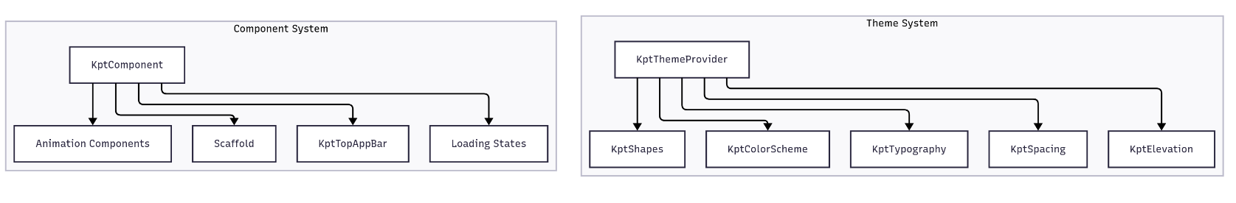
Design System and Platform Integration

Slide 10
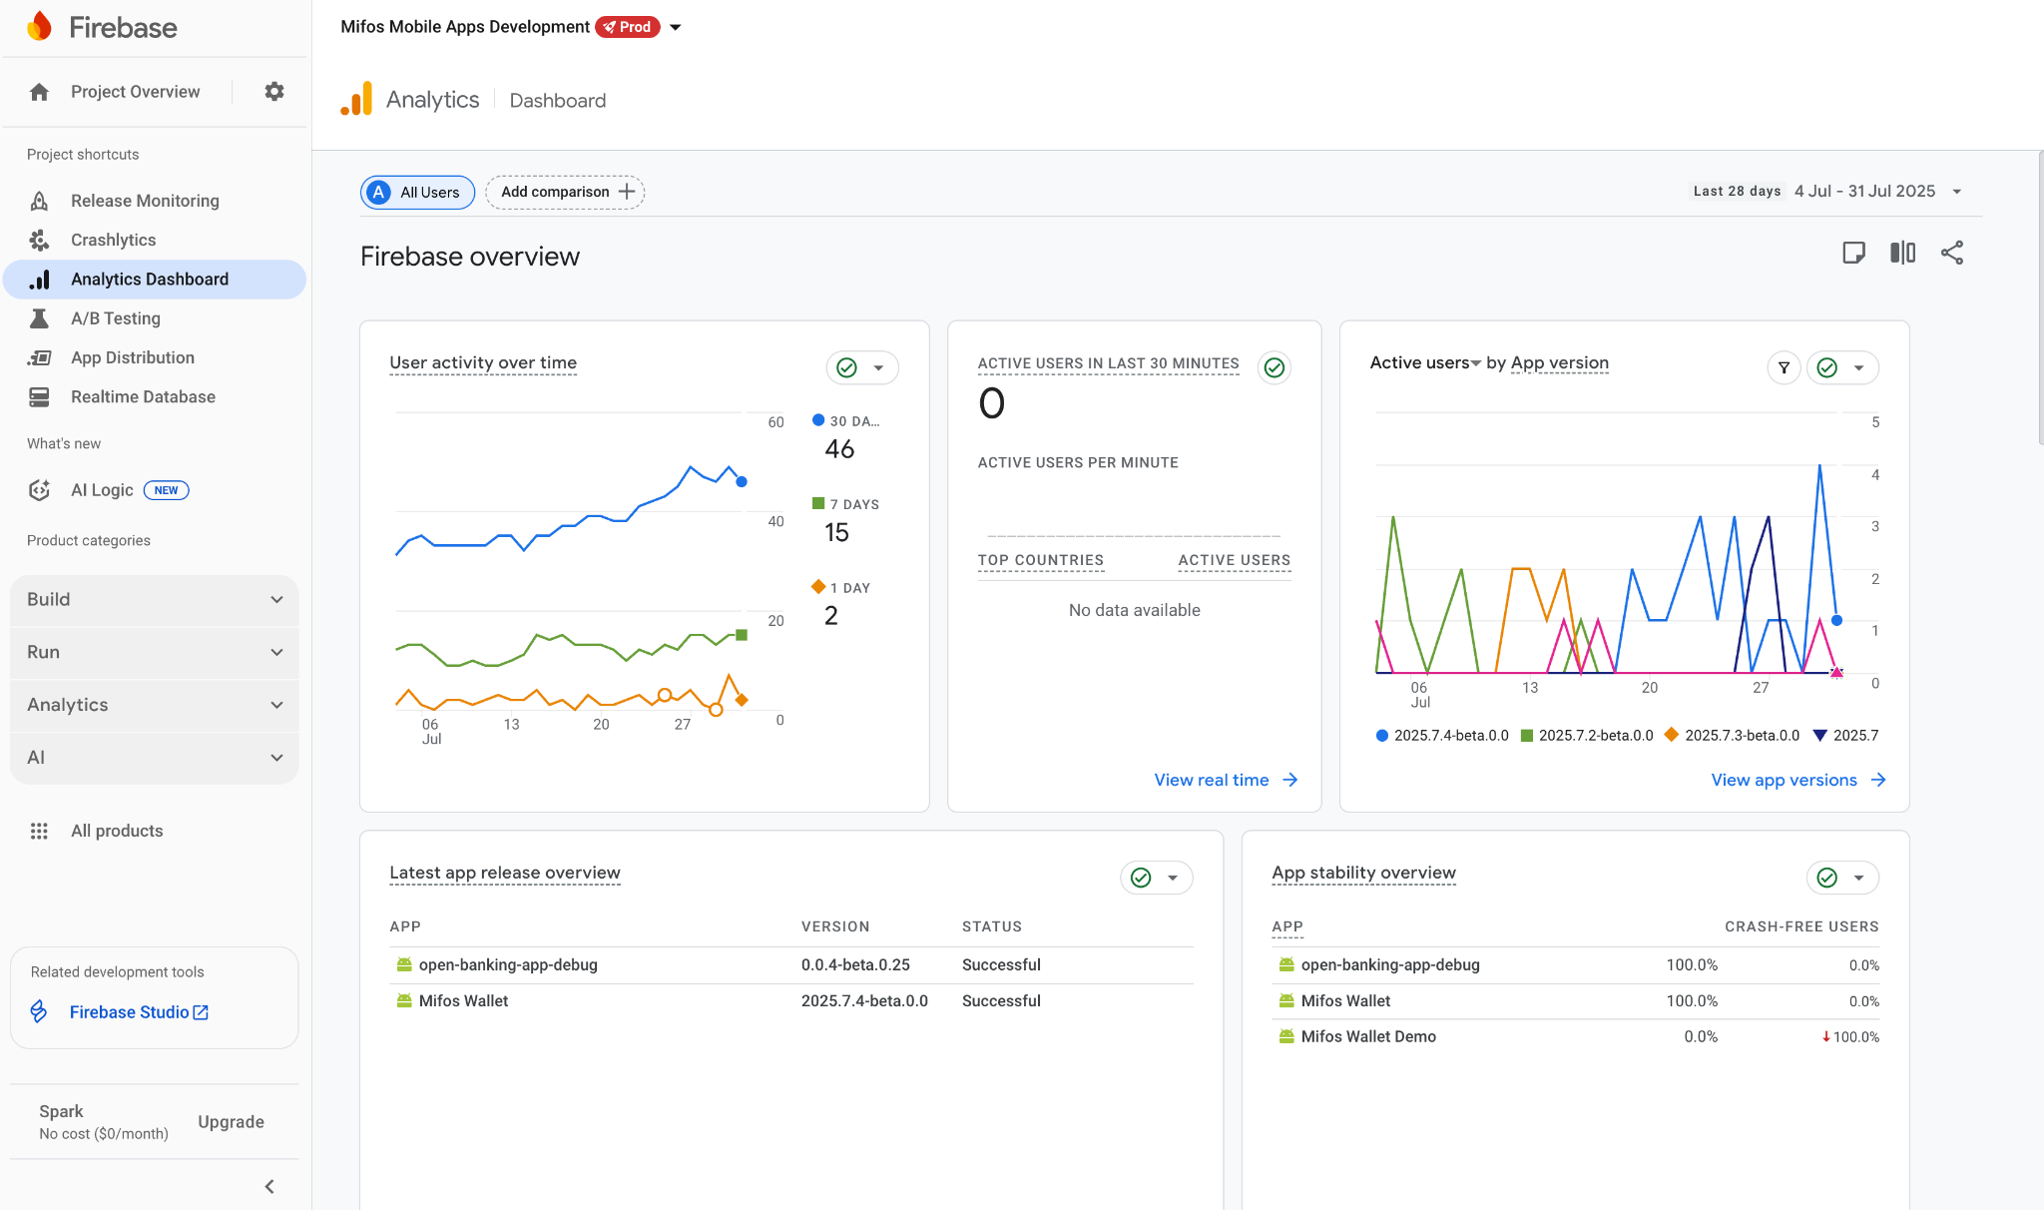
UI Foundation and Analytics Systems
Firebase Analytics Integration:
Cross-platform analytics framework with unified interfaces
Custom event tracking with type-safe event definitions
User behavior analysis with segmentation and conversion funnels
Performance monitoring integration with crash reporting capabilities
Privacy-complaint tracking supporting GDPR and CCPA requirements
UI Foundation Architecture:
State management patterns preventing common programming errors
Performance monitoring capabilities identifying bottlenecks before user impact
Responsive interface components maintaining smooth user experiences
Comprehensive error handling with graceful degradation strategies
Real-time performance metrics and optimization recommendations
Analytics Benefits:
Unified tracking implementation reducing development overhead by 80%
Real-time insights enabling data-driven product decisions
Automated performance alerts preventing user experience degradation
Comprehensive user journey analysis supporting product optimization

Slide 11
Type-Safe Navigation Framework
Navigation System Features:
Type-safe routing eliminating runtime navigation errors
Kotlin Serialization integration for parameter validation
Smooth visual transitions following platform design guidelines
Deep linking support with comprehensive parameter validation
State management integration preventing data loss during transitions
Advanced Navigation Capabilities:
Multi-module navigation with feature-specific graph organization
Conditional navigation flows based on user authentication status
Nested navigation structures supporting complex application hierarchies
Integration with platform-specific navigation patterns and behaviors
Comprehensive testing utilities for navigation flow validation
Technical Benefits:
Eliminated navigation-related crashes through compile-time validation
Improved user experience through consistent transition animations
Enhanced maintainability through centralized navigation logic
Reduced development time for complex navigation requirements by 50%

Slide 12
Challenges and Technical Solutions
Challenge 1: Multi-Platform Configuration Complexity
Problem: Different platforms requiring incompatible build configurations
Solution: Unified configuration system with platform-specific generators
Result: 90% reduction in configuration-related development issues
Challenge 2: Secure Keystore Management
Problem: Manual keystore handling creating security risks and deployment bottlenecks
Solution: Automated keystore generation with encrypted storage and CI/CD integration
Result: Zero security incidents and 100% automated deployment success rate
Challenge 3: Template Synchronization
Problem: Inability to incorporate upstream improvements without losing customizations
Solution: Intelligent synchronization system with conflict resolution and selective adoption
Result: 95% successful template updates with complete customization preservation
Challenge 4: Cross-Platform Analytics Consistency
Problem: Platform-specific analytics implementations creating development overhead
Solution: Unified analytics framework with platform-specific optimizations
Result: Consistent tracking across all platforms with 80% development effort reduction

Slide 13
THANK YOU!

